Slide 1
INTRODUCTION TO MACHINE LEARNING & DATA SCIENCE
NEVILLE
ANUSHA

Slide 2
WORKSHOP OUTLINE
Overview
Introduction
Data Types
2. Supervised Machine Learning
Classification & Regression in ML
Linear Regression
Logistic Regression
Decision Trees
Regression & Classification Metrics
3. Unsupervised Machine Learning
Clustering
K-Means
Gaussian-Mixture

Slide 3
OVERVIEW
01

Slide 4
Introduction
With the increasing amounts of data generated in our world, data science is becoming increasingly popular
Data Science brings together domain expertise from various fields to create insights and make sense of data
Machine Learning are tools or techniques used to allow computers/devices to learn from data to make data driven decisions in the field of data science

Slide 5
Data Types
Categorical
Data that can be divided into groups
Example: Age, Race, Gender
Numerical
Values represented by numbers, either integers or decimals
Time-Series
Series of data points indexed in time order
Example: Revenue over a time period, Stock price over a time period
Text
Words, Sentences
Example: Customer Reviews

Slide 6
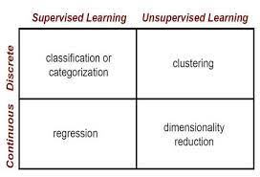
Supervised vs Unsupervised
Supervised Learning Models are trained using labelled data
Unsupervised Learning Models are trained using unlabelled data

Slide 7
02
SUPERVISED MACHINE LEARNING

Slide 8
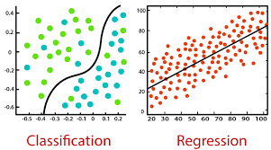
Classification & Regression
Classification is about predicting a discrete class label while Regression is about predicting a continuous quantity
A classification algorithm predicts the probability of a class label based on the inputs
Classification predictions can be evaluated using accuracy, whereas regression predictions cannot

Slide 9
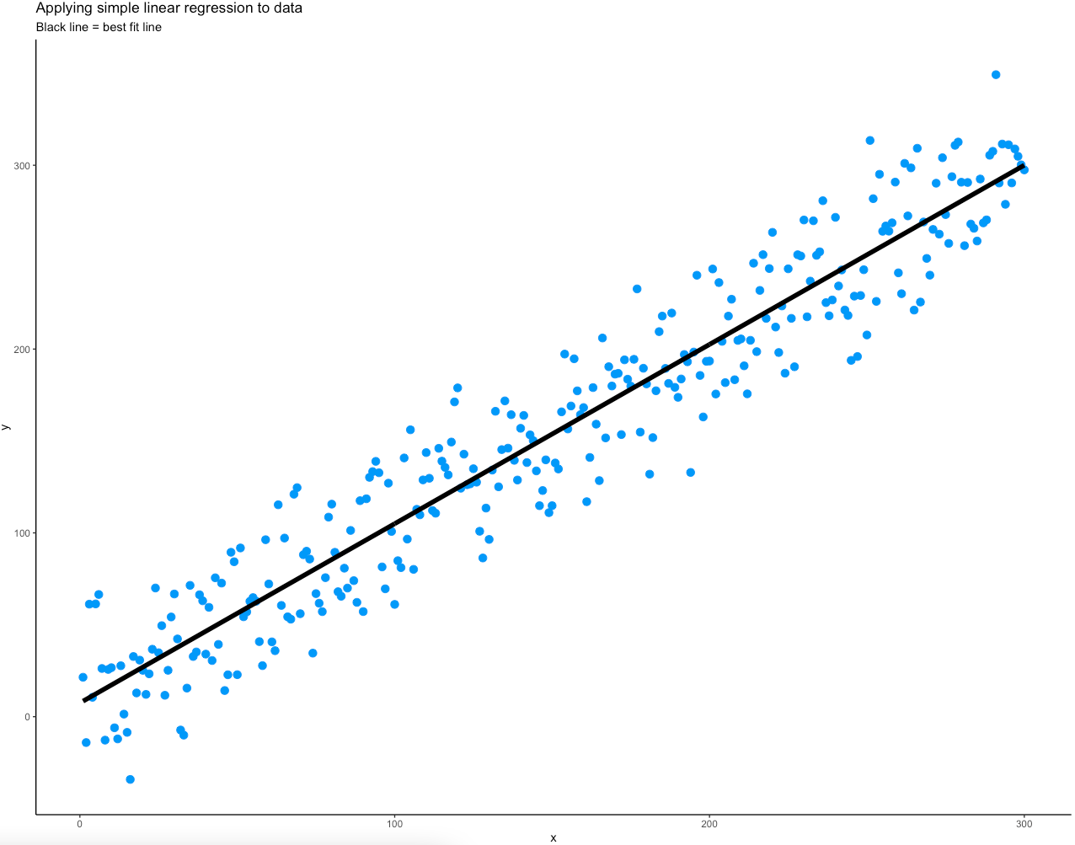
Linear Regression
Linear Regression is a model where we try to establish a linear relationship between a dependent variable y and one or more dependent variable X
The objective is to fit the best fit of a straight line that will try to minimize the error between the expected value predicted value

Slide 10
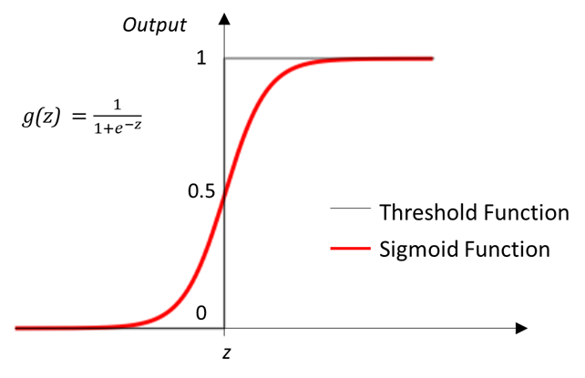
Logistic Regression
Implemented for Binary Classification Problems
A linear relationship is first established between y and X and then passed into the sigmoid function
The output is the estimated probability of the data belonging to a class label.
Default threshold value used is 0.5 to determine the class labels

Slide 11
Linear vs Logistic Regression
Linear Regression | Logistic Regression
Used for Regression Problems Regression line is linear Output is continuous | Used for Binary Classification Problems Regression line follows the sigmoid function Output is Continuous but represents the probability of the data belonging to the discrete binary class label (0 or 1)

Slide 12
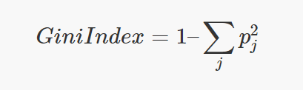
Decision Trees (CART)
Decision Tree is a Supervised Learning Model that can be used in classification and regression Problems
The CART Algorithm is one of the most common way to split Decision Trees based on the Gini Impurity as it requires less computational power
Gini Index (Gini Impurity) measures the ‘impurity’ of a node

Slide 13
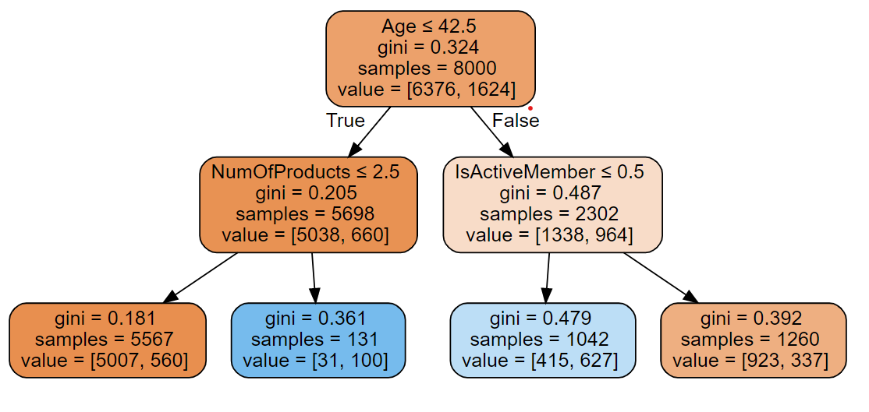
Decision Trees (CART)
The goal of a Decision Tree is to reach a pure node, that is when gini index is 0
this means that all the elements in the node are of one unique class.
The optimum split is chosen by the features with lowest Gini Impurity. The Decision Tree Algorithm loops through every single variable and every single value of the variable possible

Slide 14
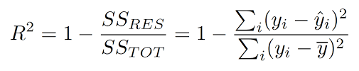
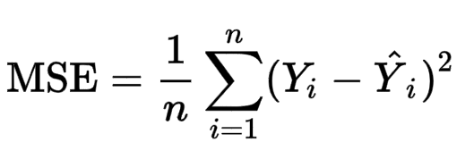
Regression Metrics
Metric | Description
R^2 | Values between 0 and 1 Measure of how regression line fit the actual values A higher R^2 value generally means that the model is a better fit
Mean Square Error (MSE) | Average of the square of the errors between predicted and expected values The larger the MSE the larger the error present in the Regression Model

Slide 15
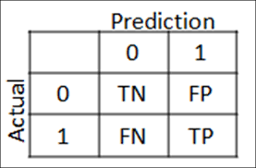
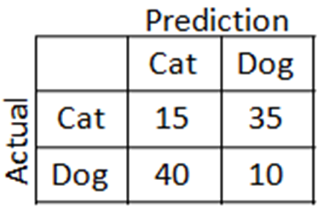
Classification Metrics
Accuracy = (TP+TN)/N
N = TP + TN + FN + FP
Accuracy = (15+10)/100 = 0.25

Slide 16
Classification Metrics
Metric |  | Description
Precision | TP/(TP+FP) | When FP is much more important For example, wrongly classifying a normal email as spam (False Positive) might make a user miss a important email
Recall | TP/(TP+FN) | When FN is much more important For example, wrongly classifying a covid-19 patient as negative (False Negative) is detrimental
F1-Score | 2*(Precision+Recall)/(Precision*Recall) | Harmonic Mean between Precision and Recall Measure of a model’s accuracy

Slide 17
03
UNSUPERVISED MACHINE LEARNING

Slide 18
~ Yan Lecun, VP and Chief AI scientist at Facebook
Unsupervised learning - teaching machines to learn for themselves without the need to be explicitly told if everything they do is right or wrong - is the “true AI”

Slide 19
What is Unsupervised Learning?
Data given to the algorithm is not labelled, i.e only input variables (x values) are given without their corresponding output variables (y values).
Algorithms are left to discover interesting structures in the data on their own without the user’s inputs/observations.

Slide 20
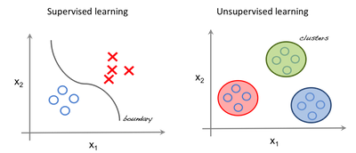
Supervised vs. Unsupervised Learning
Supervised - we use regression techniques to find the best fit line between the features.
Unsupervised - inputs are segregated based on features and prediction is based on which cluster it belongs to.

Slide 21
Important Terminology
Feature: An input variable used in making predictions.
Predictions: A model’s output when provided with an input example.
Example: One row of a dataset. An example contains one or more features and possibly a label.
Label: Result of a feature.

Slide 22
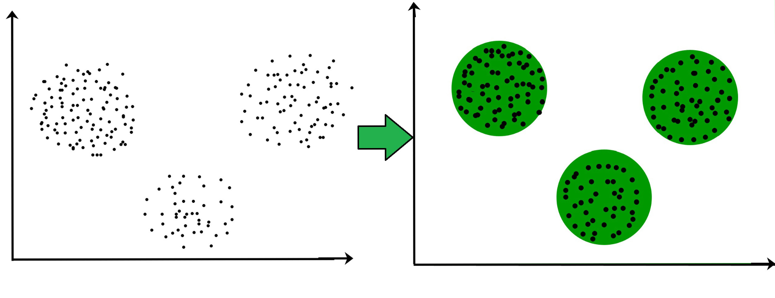
Clustering in Unsupervised Learning
It is the process of grouping similar entities together. The goal of this unsupervised machine learning technique is to find similarities in the data point and group similar data points together.

Slide 23
Types of Clustering
K-Means
Mixture of Gaussians
Spectral
Mean Shift etc.

Slide 24
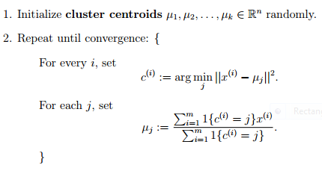
K-Means
In this algorithm, we have to tell the algorithm how many possible clusters ( or K ) there are in the dataset. The algorithm then iteratively moves the k-centers and selects the data points that are closest to the centroid in the cluster.

Slide 25
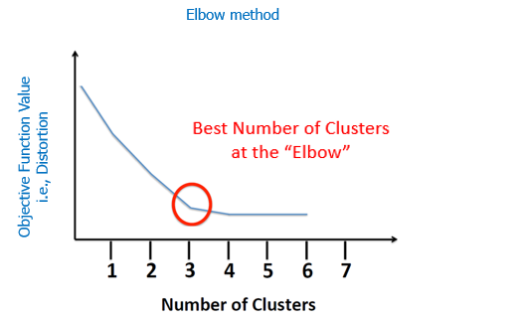
# How to find the K-value
Elbow Method
The x-axis is the K-value and the y-axis is some objective function. A common objective function is the average distance between the data points and the nearest centroid.
The best number for K is the “elbow” or kinked region. After this point, it is generally established that adding more clusters will not add significant value to our analysis

Slide 26
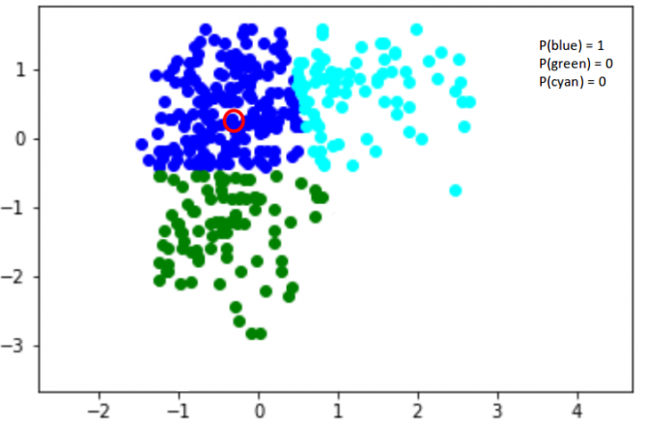
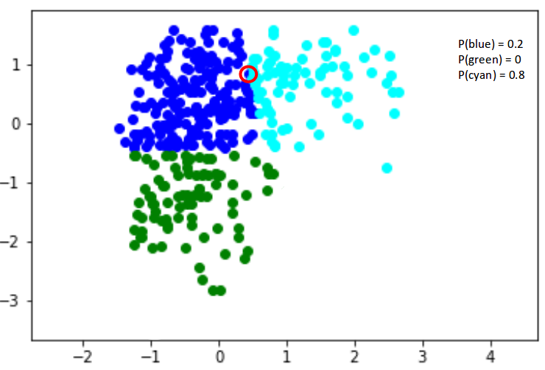
Gaussian Mixture Model
It is a probabilistic model that uses the soft clustering approach for assigning data points to Gaussian distributions.

Slide 27

FeedBack Form

Slide 28
THANK YOU
Do you have any questions?

